Slide 1
MOBILITY & TRANSPORT ANALYTICS
Urban Mobility Intelligence
Four Power BI dashboards translating ride-hailing, micro-mobility, vehicle-type and demand-forecasting data into operational insight
Rickshitha A

Slide 2
What This Portfolio Covers
A city-wide view of mobility — from booking a ride to forecasting tomorrow's demand
01
Ride-Hailing Intelligence
Demand, surge pricing, wait times and vehicle availability across Chennai zones
Portfolio Snapshot
766K
02
Micro-Mobility Analytics
ride requests analyzed
Bike/scooter trip volume, station utilisation, and availability by station
103K
03
Vehicle Type Analysis
micro-mobility trips
Mode-share comparison and substitution patterns across weather conditions
4
transport modes compared
04
Demand Forecasting
Zone-level demand trends, forecasts and supply-gap analysis
3-mo
demand forecast horizon
02

Slide 3
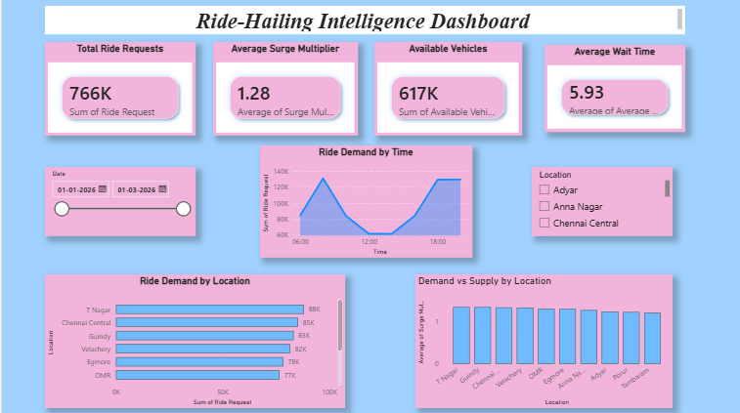
01
Ride-Hailing
Intelligence Dashboard
Tracks live ride demand, surge pricing and vehicle supply across Chennai locations (T Nagar, Chennai Central, Guindy, Velachery, Egmore, OMR) to keep wait times low.
766K
Total ride requests
1.28x
Avg. surge multiplier
Peak demand occurs at midday and evening hours; T Nagar and Chennai Central lead ride requests, while supply (surge) stays fairly even across zones — signalling a location-based allocation opportunity.
617K
Available vehicles
5.93 min
Avg. wait time
03

Slide 4
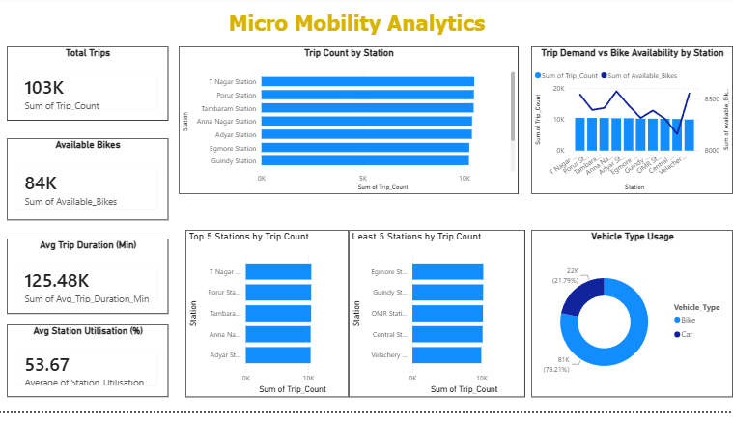
02
Micro-Mobility
Analytics
Monitors bike/scooter trip counts, station-level utilisation and available-bike balance across 7 stations to guide rebalancing.
103K
Total trips
84K
Available bikes
125.5
T Nagar and Porur stations post the highest ride volume while Egmore and Guindy trail — and bikes (78%) heavily outnumber cars (22%) in the fleet mix, reinforcing bike-first rebalancing priorities.
Avg. trip duration (min)
53.7%
Avg. station utilisation
04

Slide 5
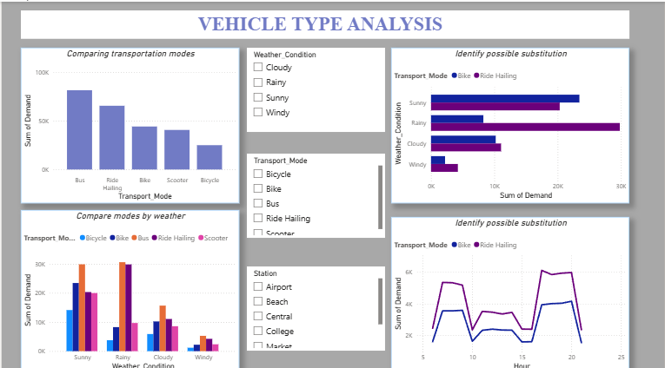
03
Vehicle Type
Analysis
Compares demand across Bus, Ride-Hailing, Bike, Scooter and Bicycle, and how weather conditions shift riders between modes.
Key Read
• Bus carries the highest overall demand, followed by Ride-Hailing
• Rainy weather pushes strong substitution toward Ride-Hailing over Bike
• Windy conditions suppress demand across every mode
The 'possible substitution' views isolate Bike vs. Ride-Hailing swings by hour and weather — a direct signal for when to reposition bikes or trigger surge pricing.
05

Slide 6
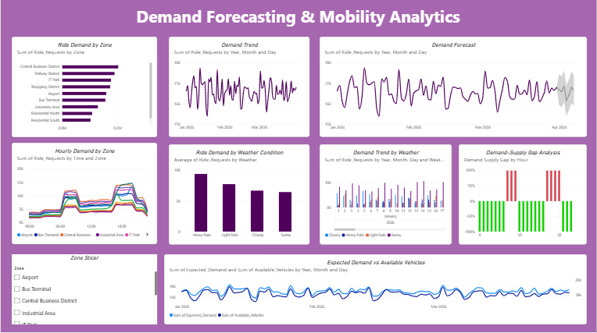
04
Demand Forecasting &
Mobility Analytics
Projects ride-request demand forward by zone and hour, and quantifies the gap between expected demand and available vehicles.
Key Read
• Central Business District and Railway Station drive the highest zone demand
• Heavy rain lifts ride demand well above light rain, cloudy or sunny days
The forecast band (dotted projection) combined with the demand-supply gap chart lets planners pre-position vehicles ahead of predicted shortfalls, rather than reacting after the fact.
• Supply-gap analysis flags recurring shortfall windows at specific hours
06

Slide 7
Bringing It Together
Across ride-hailing, micro-mobility, mode choice and forecasting, these dashboards form one connected view of urban mobility — where demand originates, how it shifts, and where supply needs to move next.
Thank You
Rickshitha A
Data Analyst | Power BI Dashboards

